Slide 1
Chat with PDFs Using Generative AI
Presented by: Batch -11 B.Tech CSE A1| Chaitanya Deemed to be University Project | April 2025

Slide 2
Introduction
PDFs are widely used in our day-to-day life.
Manually reading and finding information is time-consuming.
This project makes PDFs interactive using Generative AI.
Users can chat with their documents and get answers in seconds.

Slide 3
Goal
Build a tool where users can upload a PDF and ask questions about its content.
Reduce manual reading by allowing natural language queries.
Combine the power of OCR, embeddings, and conversational AI.

Slide 4
Objectives
Extract text from both regular and scanned PDFs.
Break content into meaningful chunks for processing.
Use vector embeddings and generative models for Q&A.
Provide citations and preserve context from the original document.

Slide 5
Methodology Overview
Upload PDF
Extract text using PyPDF2 / Tesseract
Chunk text with LangChain
Generate embeddings with Google Gemini
Query using FAISS for relevant chunks
Generate final response via Gemini

Slide 6
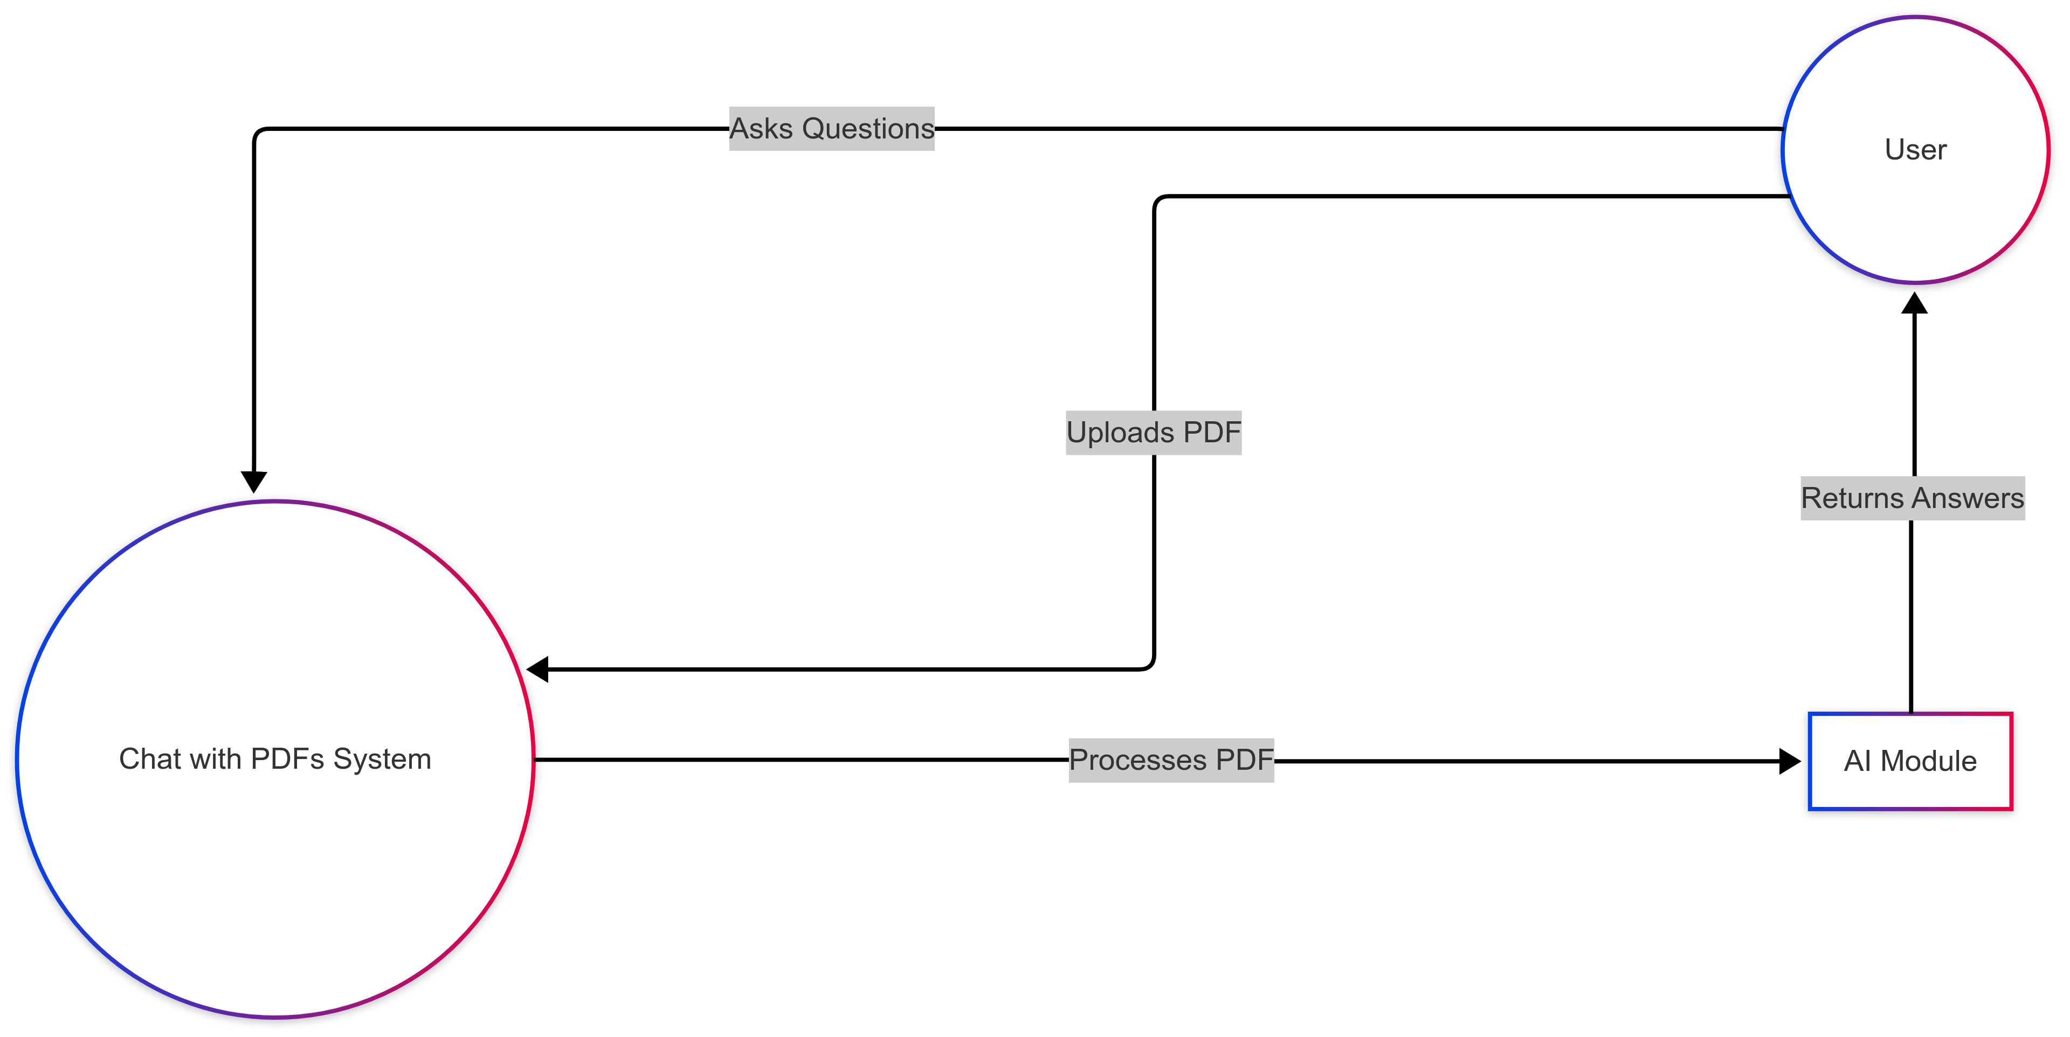
Use case diagram

Slide 7
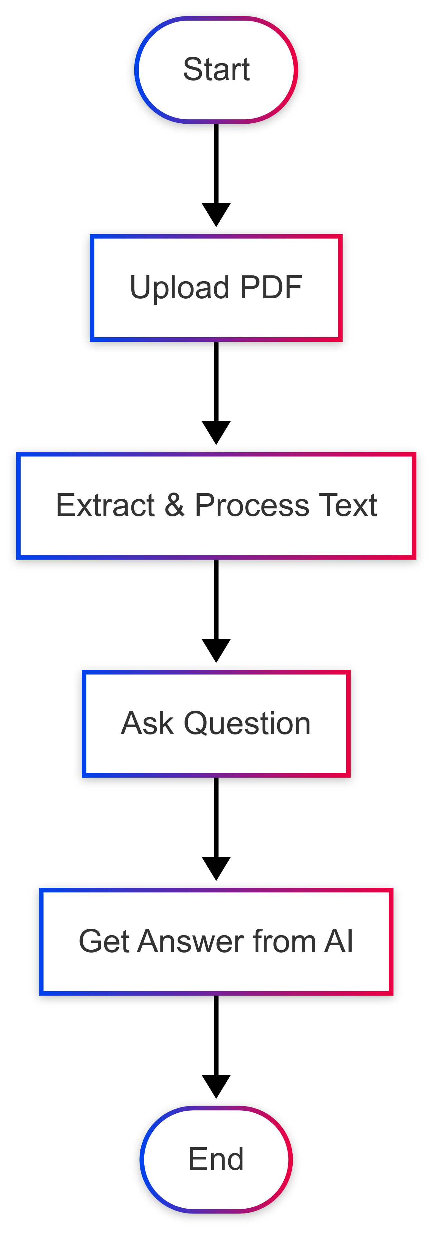
Activity diagram

Slide 8
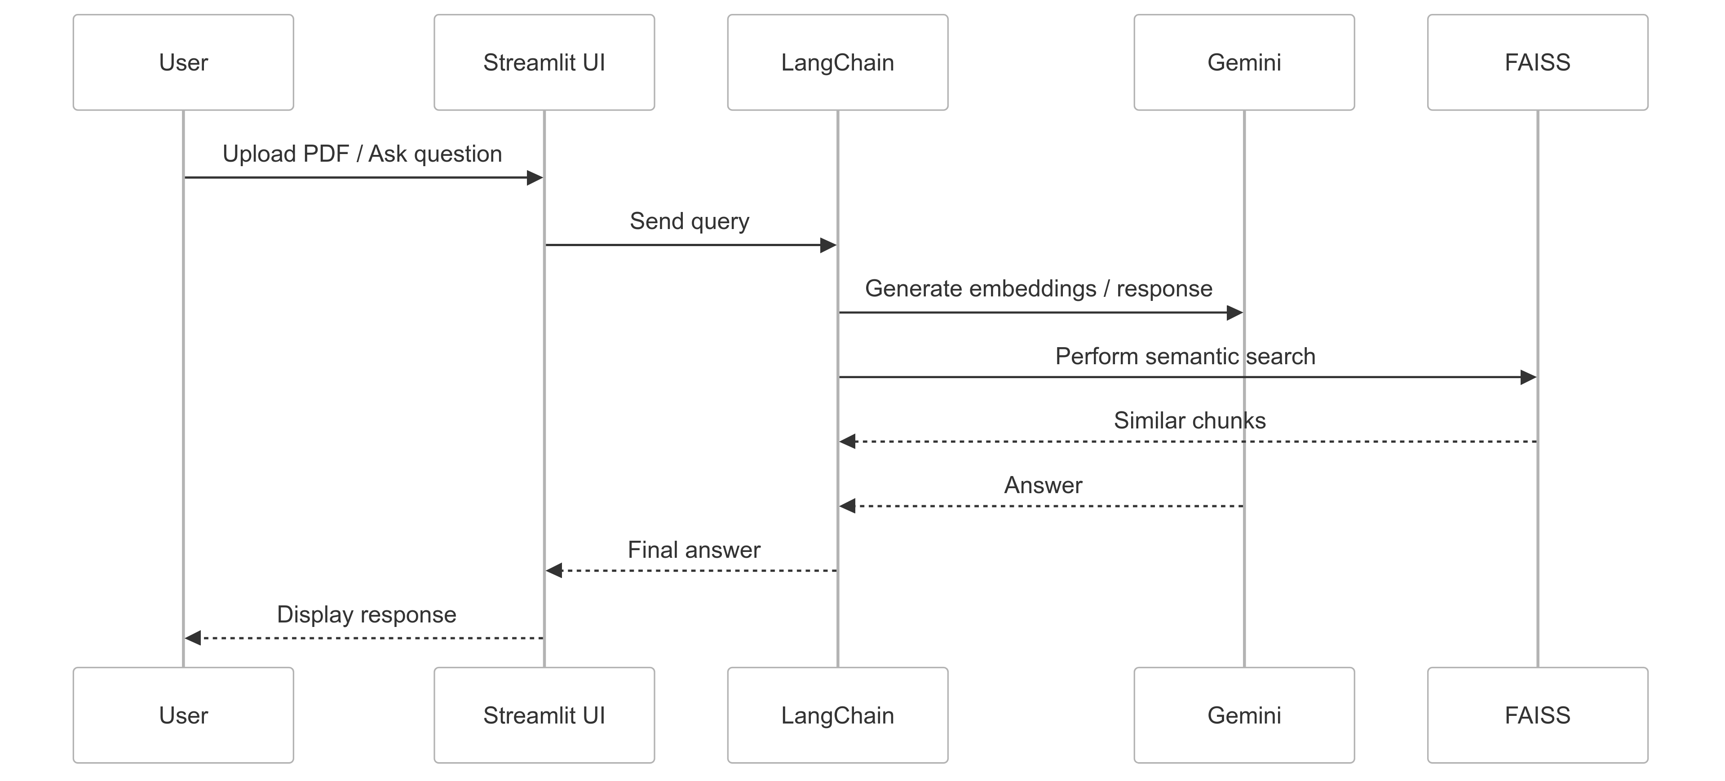
Sequence diagram

Slide 9
Data Preprocessing
Use PyPDF2 to extract text from digital PDFs.
For scanned/image-based PDFs, use Tesseract OCR.
Clean and split text using RecursiveCharacterTextSplitter.
Convert text into semantic vector embeddings.

Slide 10
Algorithms Used
Google Gemini for generating smart answers.
FAISS (Facebook AI Similarity Search) for retrieving similar content.
LangChain for managing the pipeline from query → response.

Slide 11
Technologies Used
Python for backend logic
Streamlit for UI
Tesseract OCR for scanned PDFs
PyPDF2 for text extraction
LangChain to connect components
Google Gemini API for AI responses
FAISS for semantic similarity search

Slide 12
Python (for Backend Logic)
Python is the main programming language used to build the logic of the project. It controls the flow of data, connects all tools, and ensures the system works properly behind the scenes.
Streamlit (for UI)
Streamlit is a Python-based web app framework. It lets you create interactive web applications with just a few lines of Python code. In this project, it's used to build the user interface (UI) where users upload PDFs and chat with them.
Tesseract OCR (for Scanned PDFs)
LangChain is a framework that connects AI tools, vector databases, and logic chains. In this project, it acts as a coordinator that links the user interface, AI model (Gemini), and FAISS for smooth question answering.

Slide 13
Google Gemini API (for AI Responses):
Google Gemini is a powerful generative AI model. It's used to understand user questions, analyze PDF content, and generate meaningful natural language answers.
FAISS (for Semantic Similarity Search):
FAISS (Facebook AI Similarity Search) is a library for fast vector search. It helps find the most relevant pieces of information from the PDF based on the user’s question using vector embeddings.

Slide 14
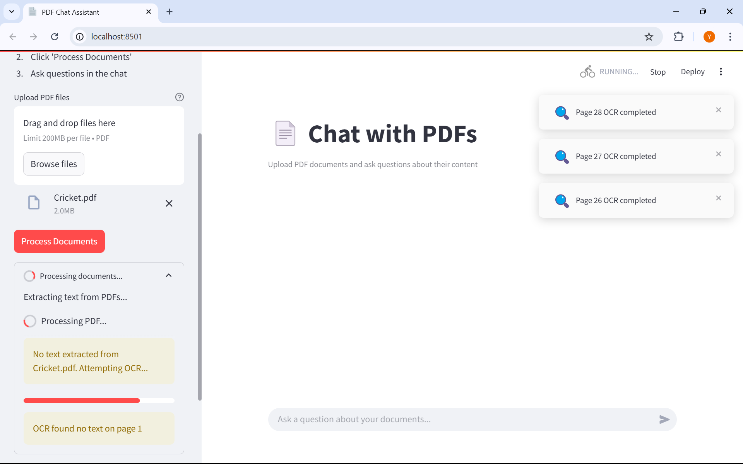

Slide 15
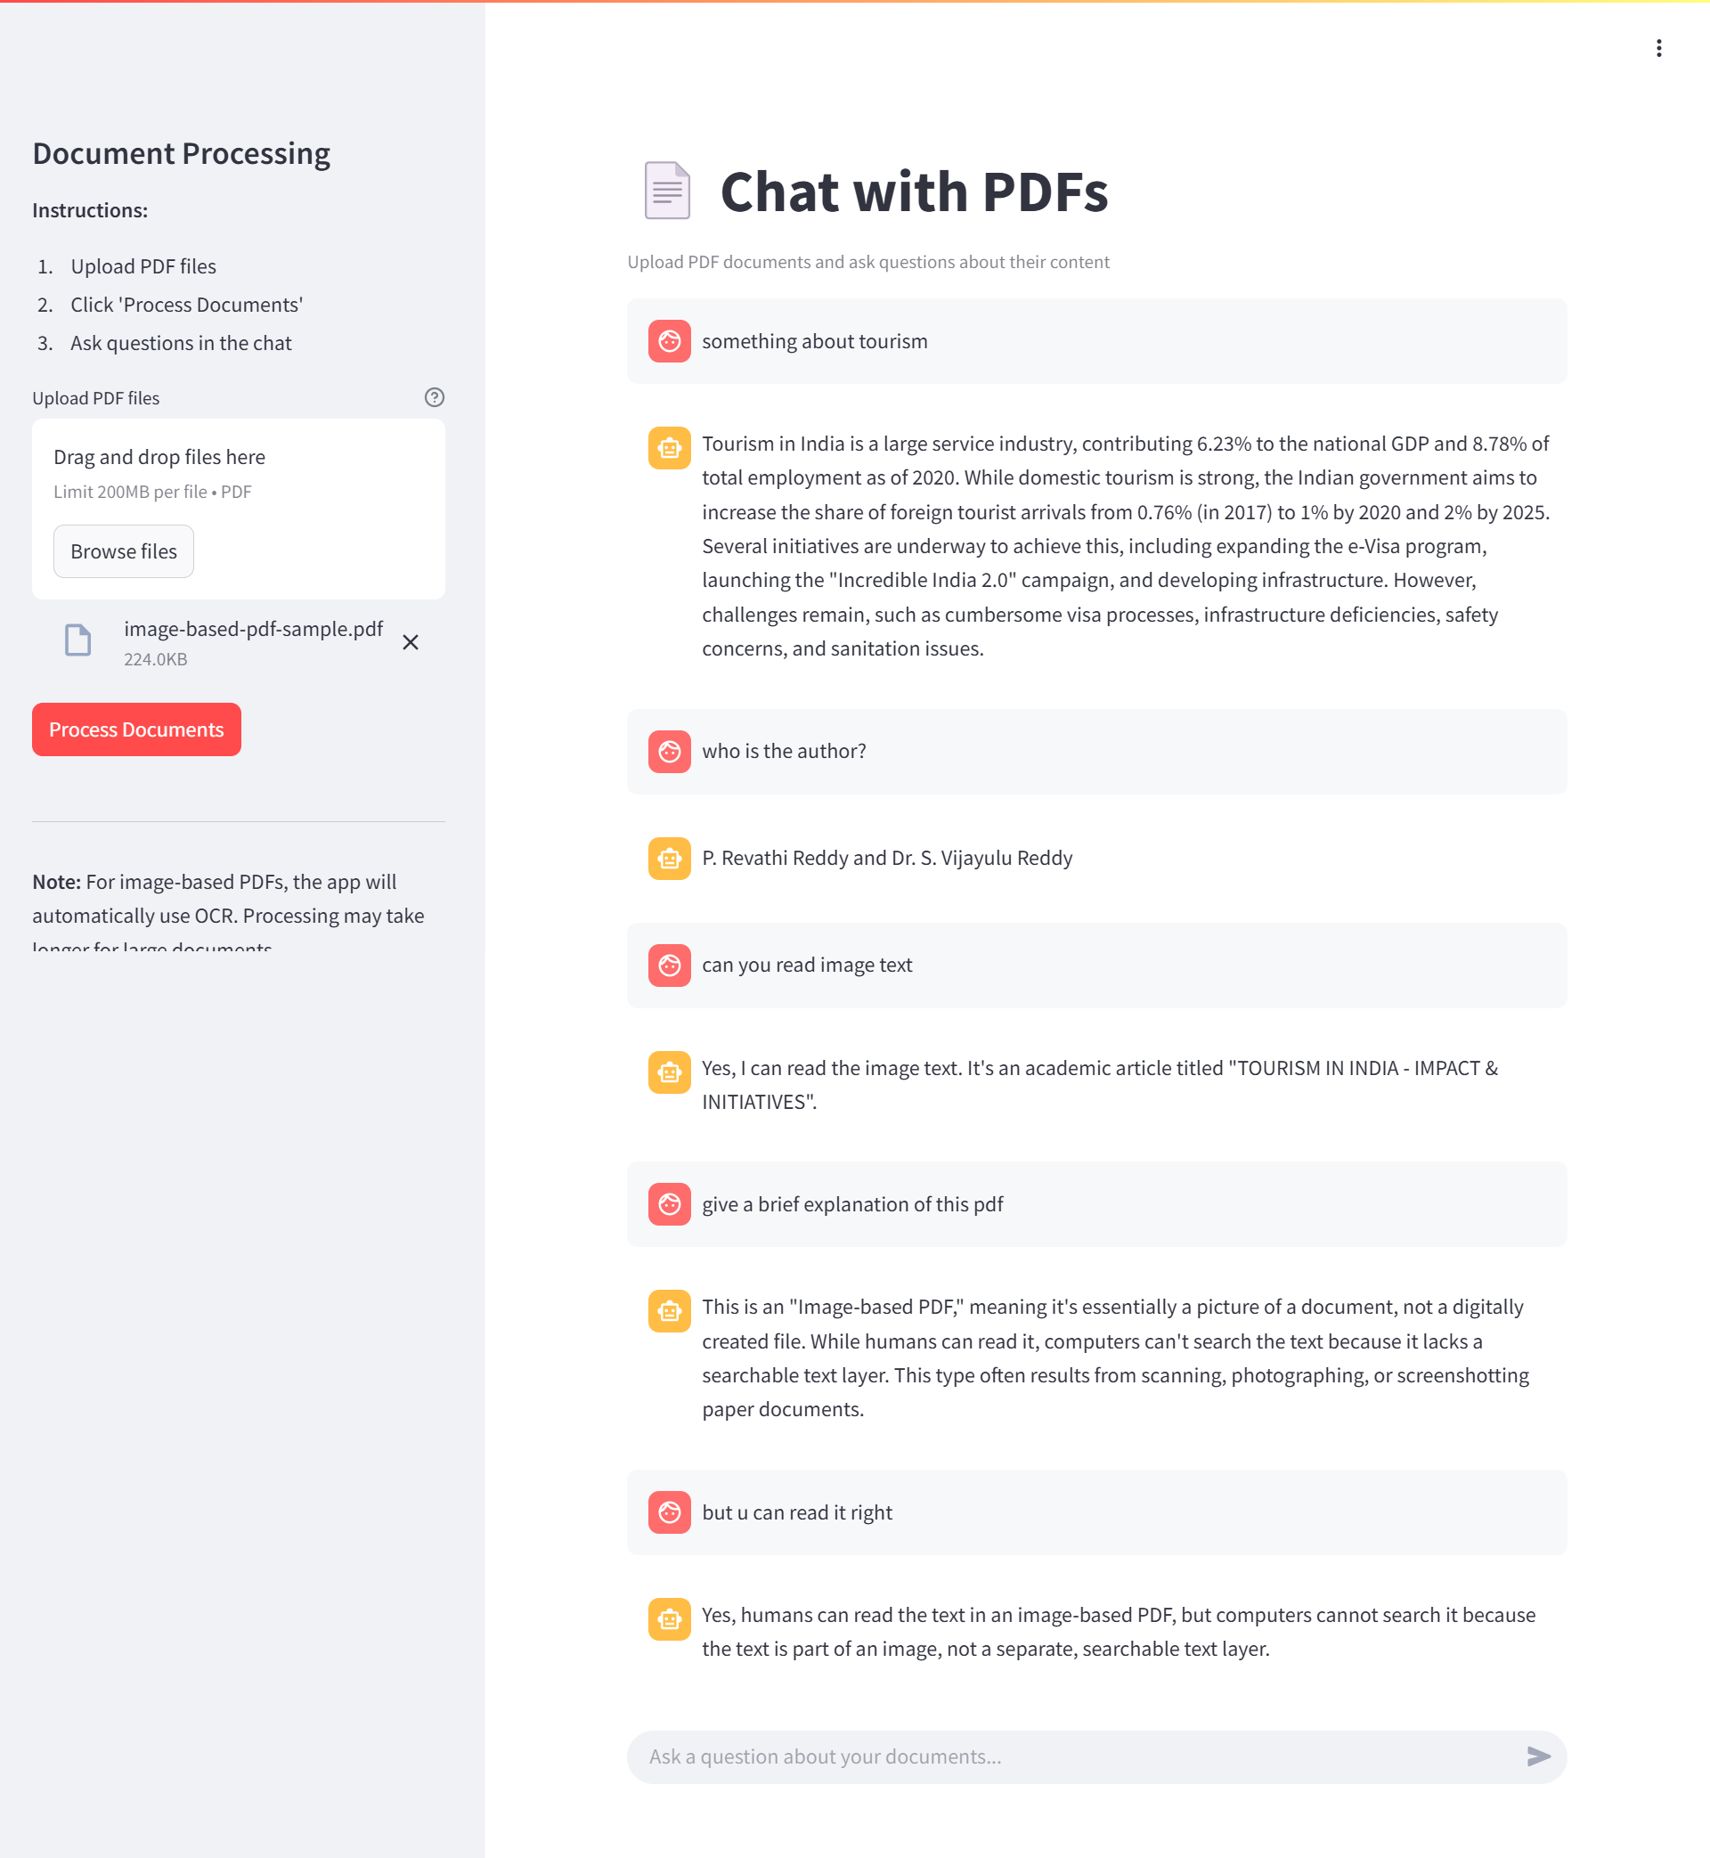

Slide 16
Functional REquirements
The system must fulfill the following functional requirements to ensure smooth operation:
Upload PDF Files – Users should be able to upload multiple PDF files for processing.
Process Text and Images – Extract text from both digital and scanned PDFs using PyPDF2 and Tesseract OCR.
Perform Semantic Search – Enable users to search for relevant content using AI-based query processing.
Answer User Queries – Provide natural language responses using Google Gemini API.
Display Conversation History – Maintain a log of user interactions for reference.

Slide 17
NON-functional rerquirements
The system should meet the following non-functional requirements to optimize performance and usability:
Response Time – Query processing time should be less than 3 seconds for an optimal user experience.
Scalability – The system should support large PDF documents (100+ pages) without performance degradation.
Security – Ensure user data privacy by implementing secure data handling and storage mechanisms.
Multi-Platform Accessibility – Should be accessible via desktop and mobile browsers using a Streamlit web interface.

Slide 18
Conclusion & Future Scope
Successfully created a smart PDF-interacting tool.
Reduces document review time drastically.
Future Additions:
Voice-based querying
Multilingual support
Export chat summaries
Mobile App version

